Slide 1
CompBox
Customer complaints are the schoolbooks from which we learn

Slide 2
T H E P R O B L E M
Mr. A's office is 3 km away from his home. So, normally, he has to take a rickshaw to reach his office. But recently the roads leading to his office were damaged due to heavy traffic loads and so now he walks to his office as the roads are not safe for rickshaws anymore. He wants to get rid of this situation. He wants to complain about his issue to the respective authority but he doesn’t know whom to reach and also what the actual procedure is. So, he is not being able to solve his issue.
So, what's the solution to Mr. A's problem?
Well, our Online Web application ‘CompBox’ is the solution!

Slide 3

A BRIEF
INTRODUCTION
An online platform which connects the mass with the government and helps the citizen notifying the govt body about the problems they are facing and facilitates the process of solving them.

Slide 4
U S E R
M O D U L E S
]
]
Step 1
Step 2
Step 3
Wait for the the complaints to get approved by the ministries after those problems are acknowledged
Post Complaints to the respective ministries and monitor his/her complaints.
Signup and login

Slide 5
M I N I S T R Y
M O D U L E S
]
]
Step 1
Step 2
Step 3
Seeing and monitoring all the complaints posted under that specific ministry.
Approving the complaints after acknowledging them.
Signup and login using ministry code

Slide 6
H I G H L I G H T S
The Complaints will be sorted both Time-wise and Area-wise
The users can delete a
complaint if they want
(before it is approved).
The ministries can approve a complaint for solving the issue.
Sorting
Deletion
Approval

Slide 7
Current Situation
Changes We Bring
Currently, there isn't any proper and structured way for the mass to reach the authority to lodge complaints to their desired authority.
People normally don't understand where to complain or to which specific ministry/dept. their complaints are aligned with.
The ministries do not have any provision to take complaints directly from the mass and also they don’t have the chance to monitor the complaints.
Our platform makes it easier for the mass to find the right place to complain about their problems.
Provides a way to the ministries to monitor all the complaints given under their names.
Creates an opportunity for the govt. to solve all the problems quickly and more effectively.
Creates an accountability based relationship between the govt. and the mass.

Slide 8









TOOLS & PLATFORMS

Slide 9
OUR TEAM
Tasfia Tabassum
170041037
Nusrat Jahan Rani
Hasnain Karim Rabib
170041044
170041040

Slide 10

THANK YOU

Slide 11
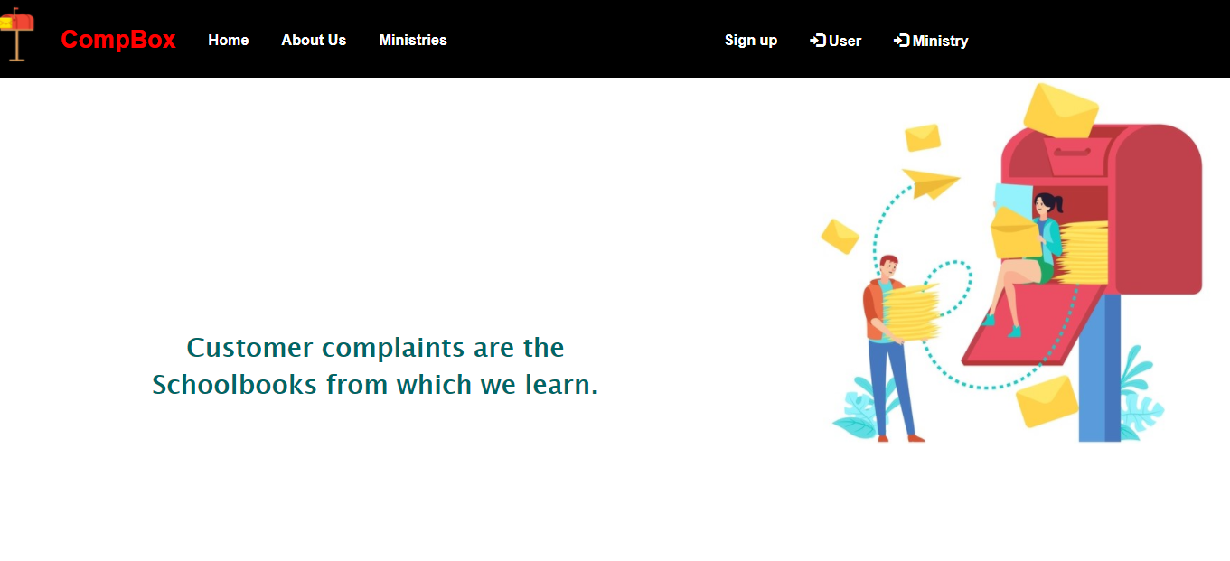

Slide 12
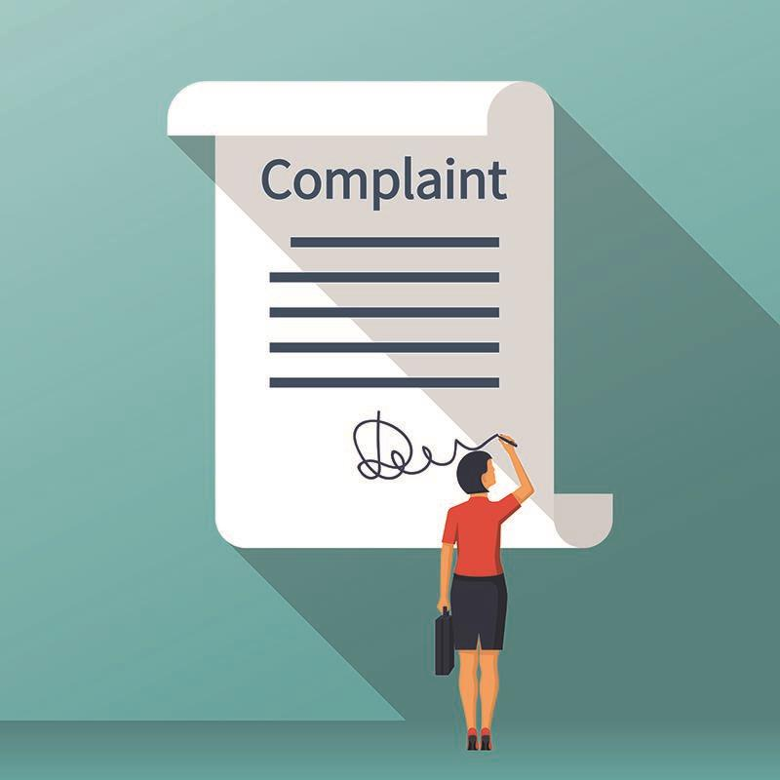
O U R I D E A
Govt. system consisting all the ministries
To get customer complaints
Complaints are area and ministry based
Approval of complaints
Having a comfortable and sound living.

